Slide 1

How can we make HuskyADAPT as sustainable program?
Joe Lawler,
NWBS 2018
¹Ability & Innovation Lab, Mechanical Engineering, University of Washington, Seattle, WA USA
²Seattle Children’s Hospital, University of Washington, Seattle, WA USA

Slide 2
Outline
Background
Project Aims
System Overview
Next Steps

Slide 3
Outline

Slide 4
Outline

Slide 5
Outline

Slide 6
Rehabilitation is challenging in CP
Background
Individual CP cases can vary by:

Slide 7
Project Aims
Project Aims
Aim
Develop a real-time feedback system capable of calculating an individual’s motor control score and updating with detected change in gait patterns
1
Aim
2
Develop and evaluate various feedback interfaces as methods of communicating motor control measurements to participants
Aim
3
Perform a preliminary two-person validation study to establish baseline measures for future modification and experimentation

Slide 8

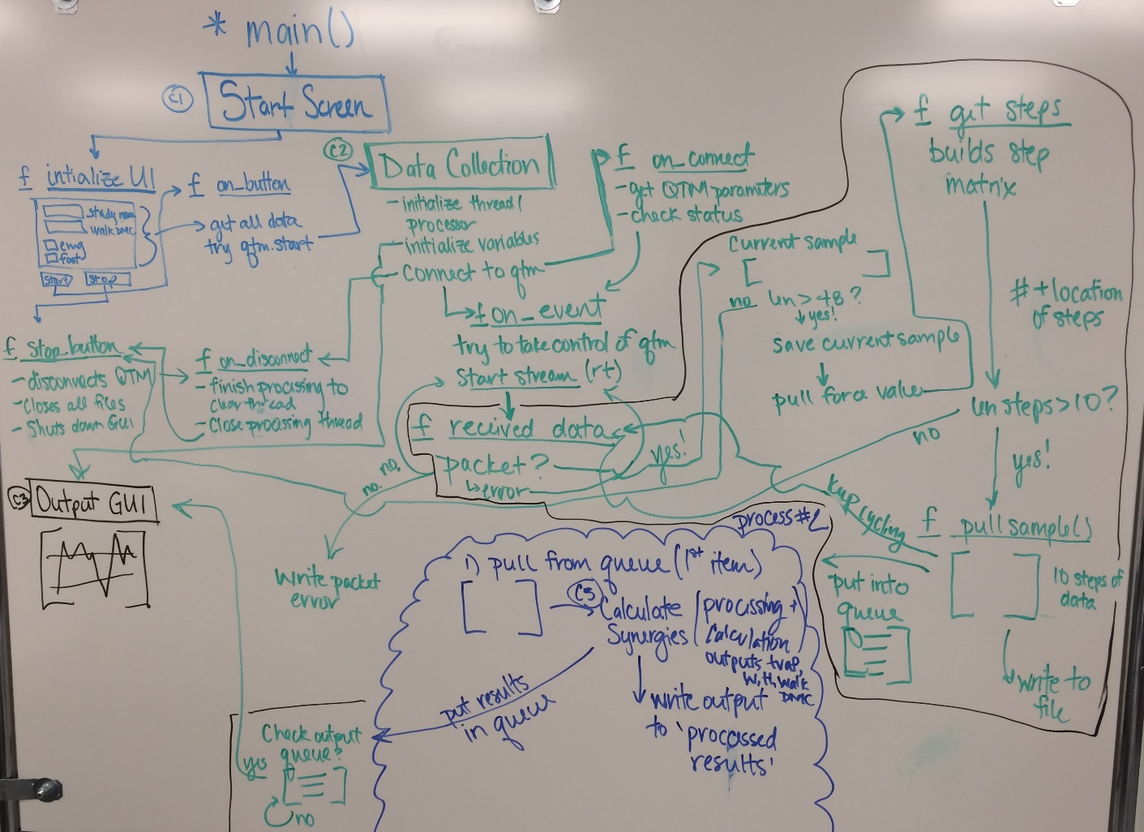
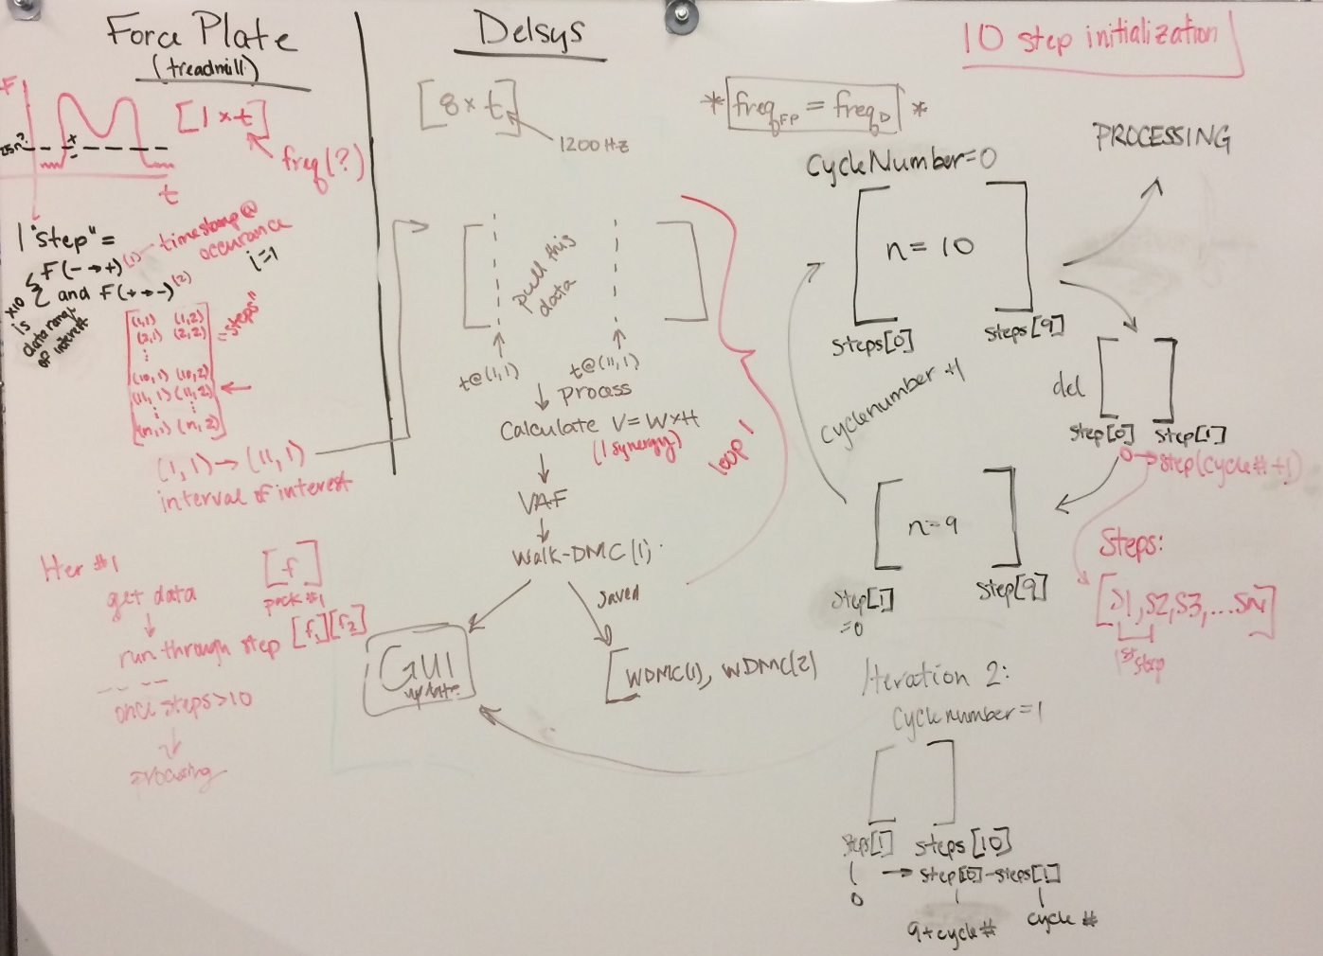

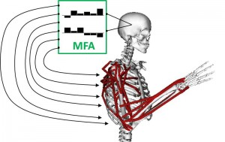
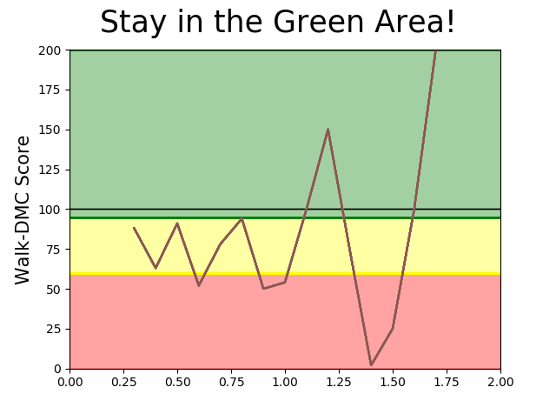


System Overview
Project Methods
Aim
1
Collection
Analysis
Feedback

Slide 9
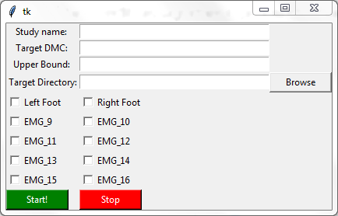
Between-trial Customization
Project Methods
Aim
1
Modifiable walk-DMC values
Trial settings, step data and count, and processed results saved to specified directory
Selection of leg studied
Selection of EMG Sensors Used
All QTM Stop/Start Functionality

Slide 10
Next Steps
Short Term
Spring 2018
Debug
> Get system fully running with minimal latency (< 0.10 seconds)
> Determine source of high frequency oscillation in GRF data
Analyze
> How sensitive is muscle synergy analysis to step-to-step variation?
Defines:
> Length of time a person will need to ‘hold’ a specific gait pattern to see a change in walk-DMC
> True system latency
Test
> Perform two-person pilot study to validate underlying system mechanics and provide baseline metrics for future studies
Aim
3

Slide 11
Next Steps
Medium Term
1.
To what extent can an individual modulate their motor control when presented with real-time feedback?
A pilot study will be performed to evaluate range and type of motor control change
Baseline Metrics:
No feedback
Feedback – exploration
Analysis of:
> Range of walk-DMC scores
> Muscle synergy activation patterns and weight changes
> Kinematic strategies adopted
> Differences between feedback and non-feedback conditions
10 Typically Developing
Individuals
*
Targeted feedback:
Walk-DMC +/- 1 std. dev
Walk-DMC +/- 2 std. dev
* Performed in randomized order

Slide 12
Thank you!
Questions?

